Slide 1
CampuStore
Innovation for long life learning

Slide 2
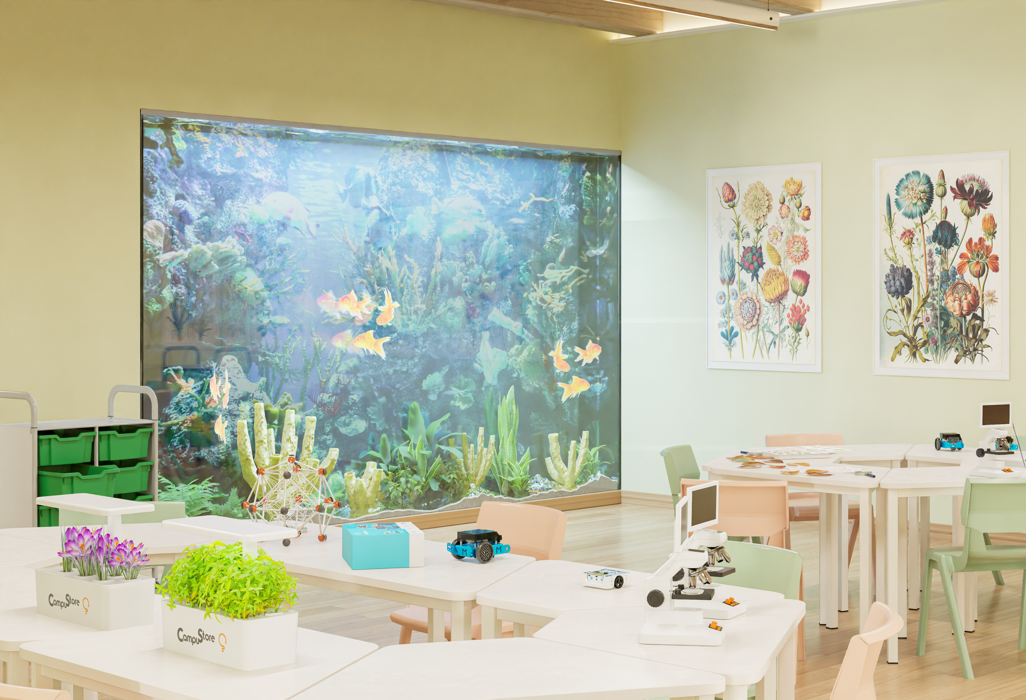
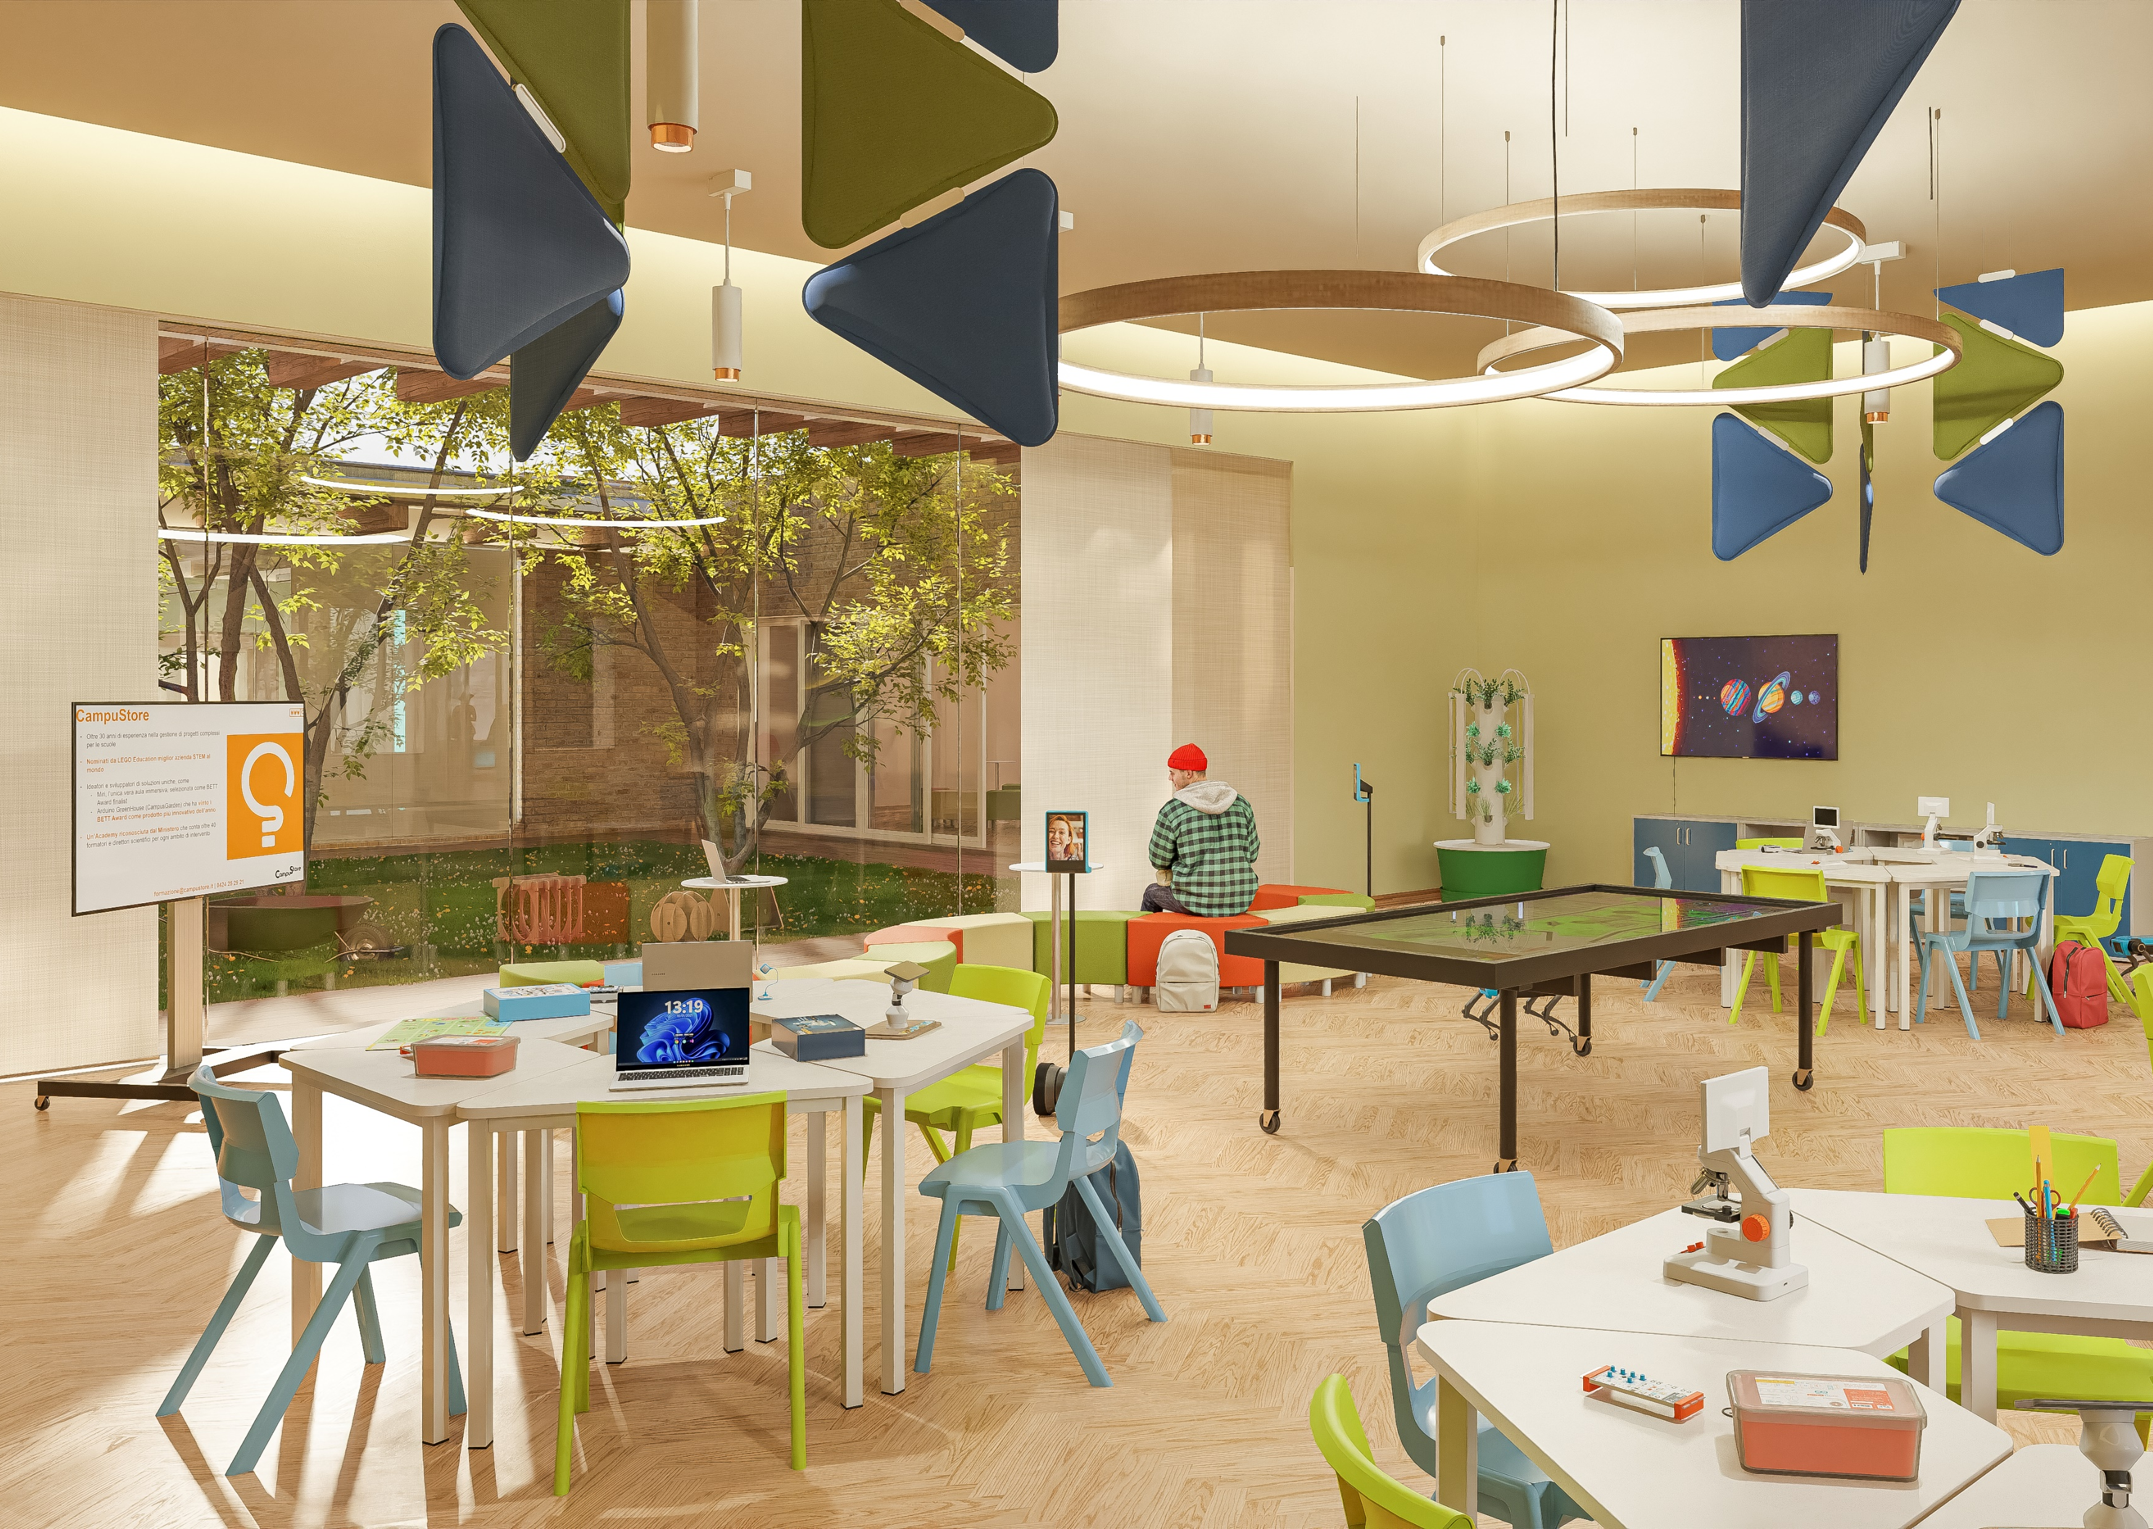
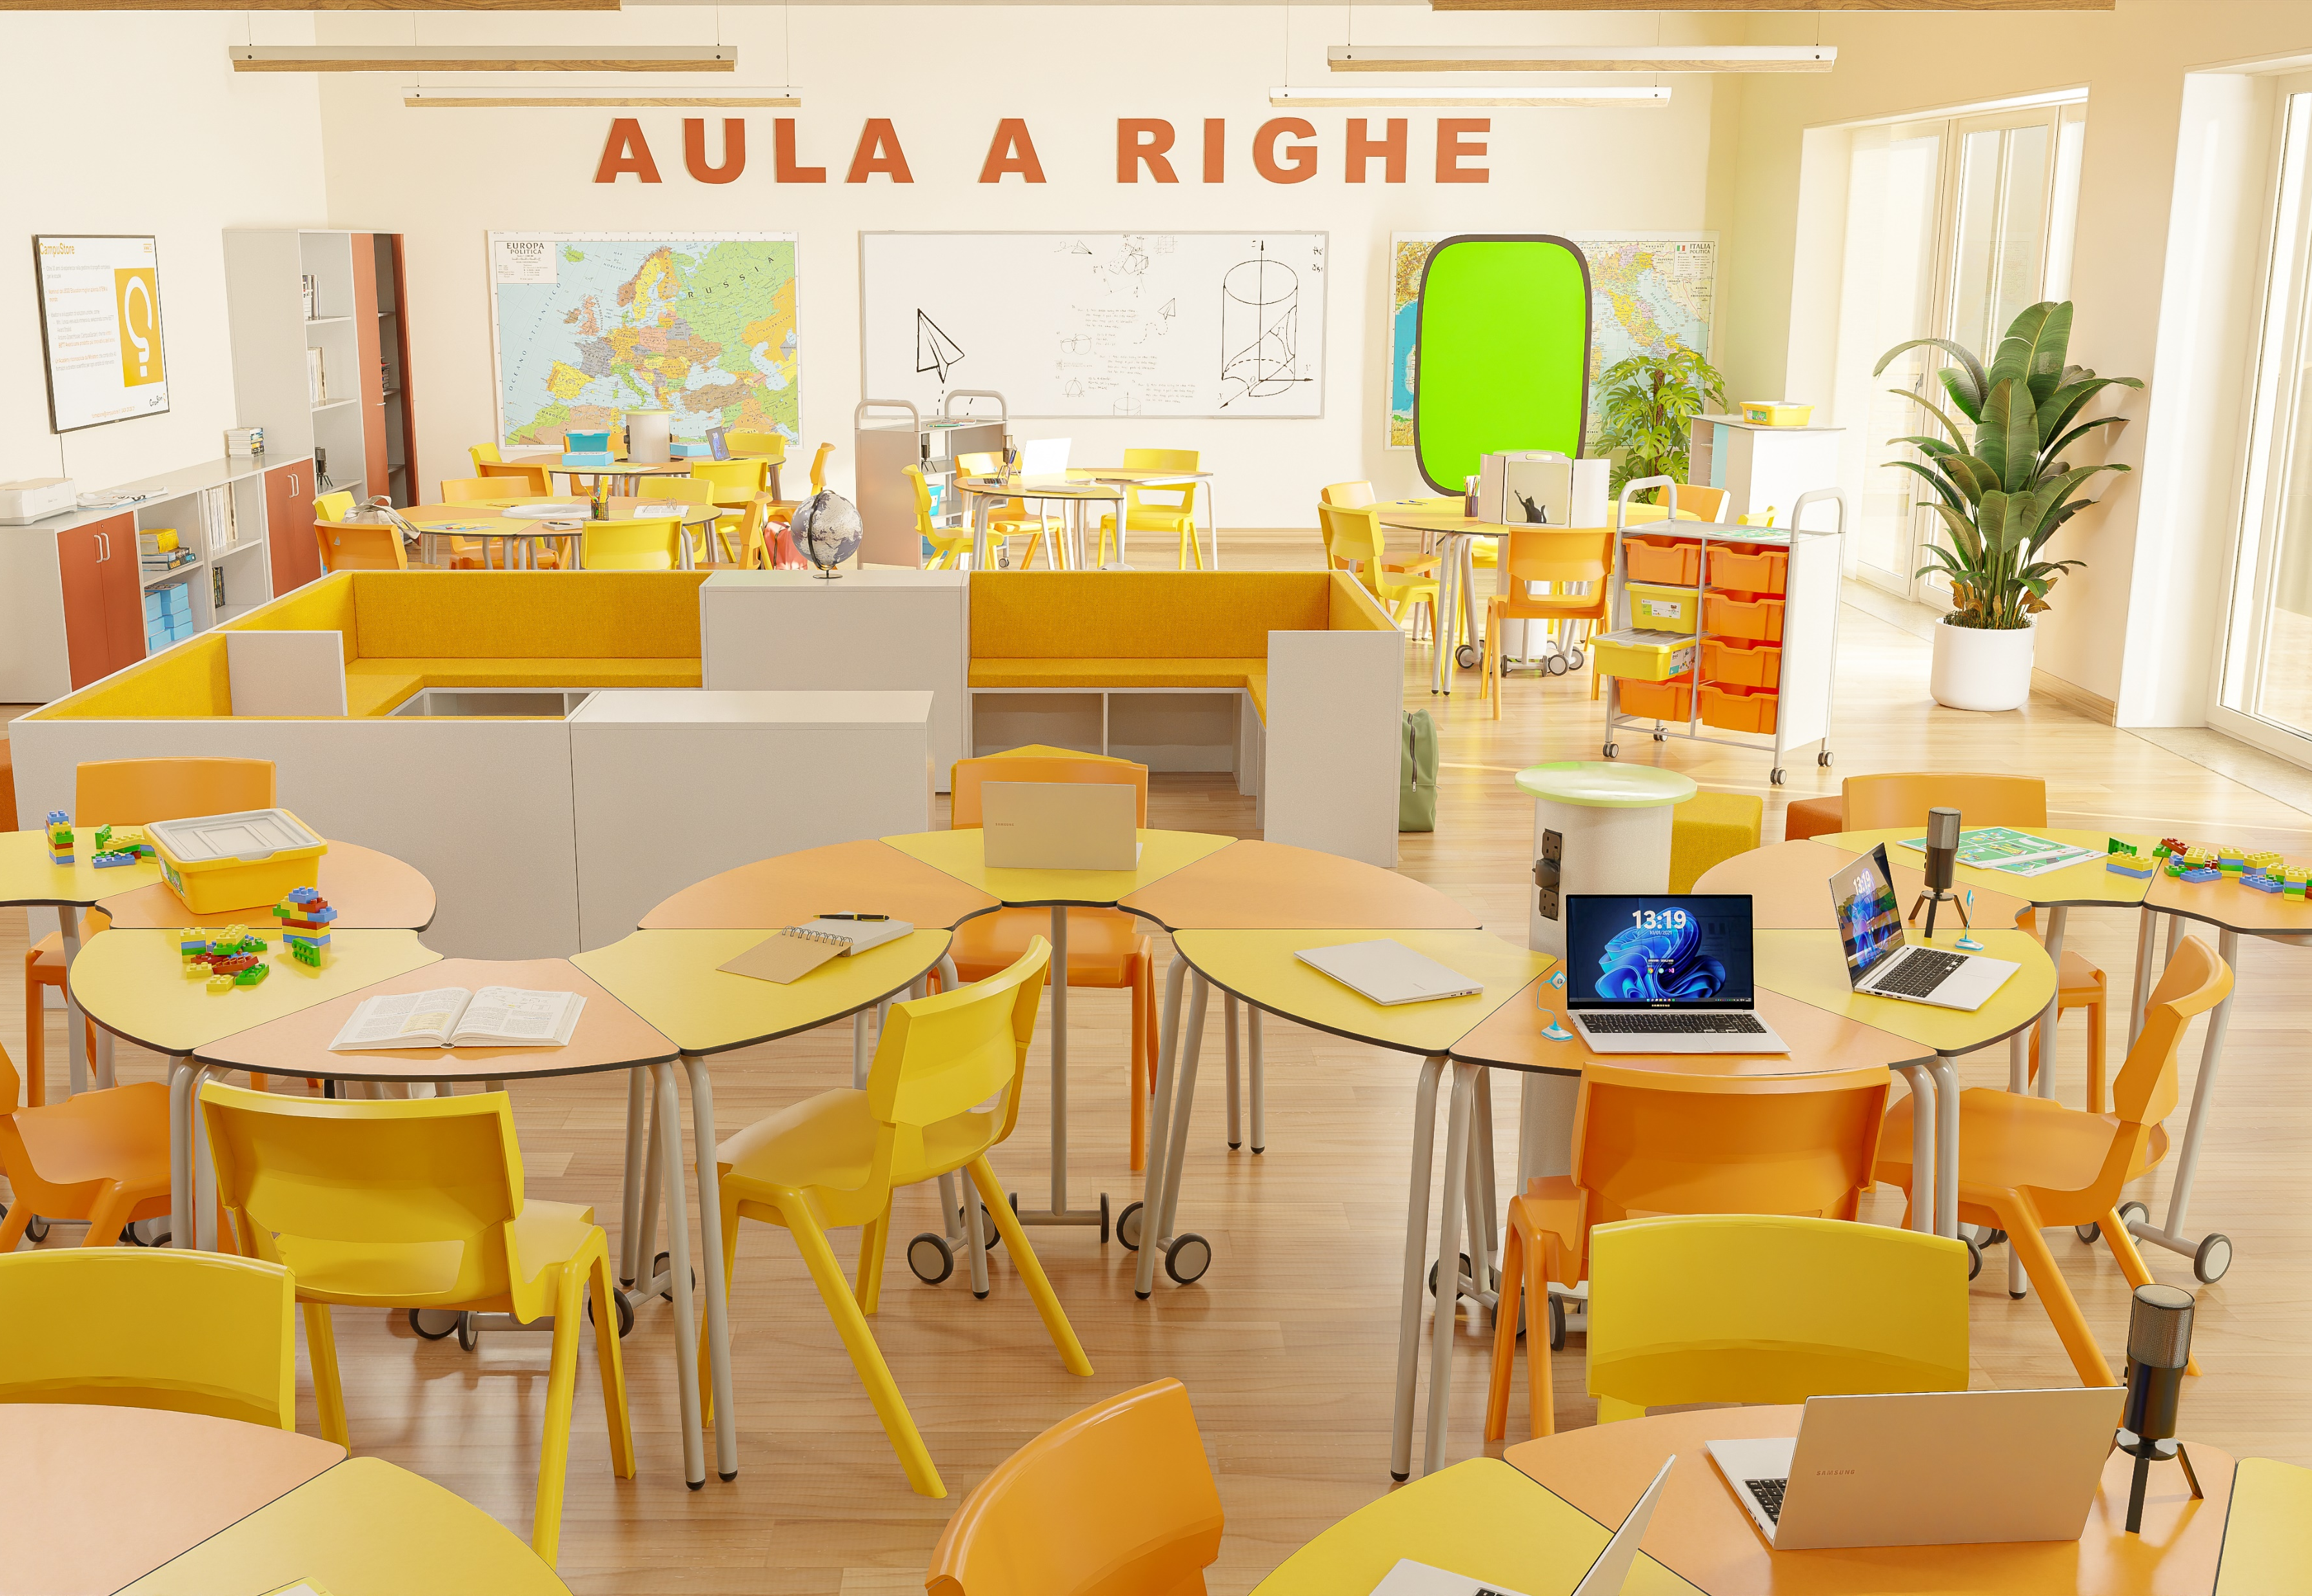
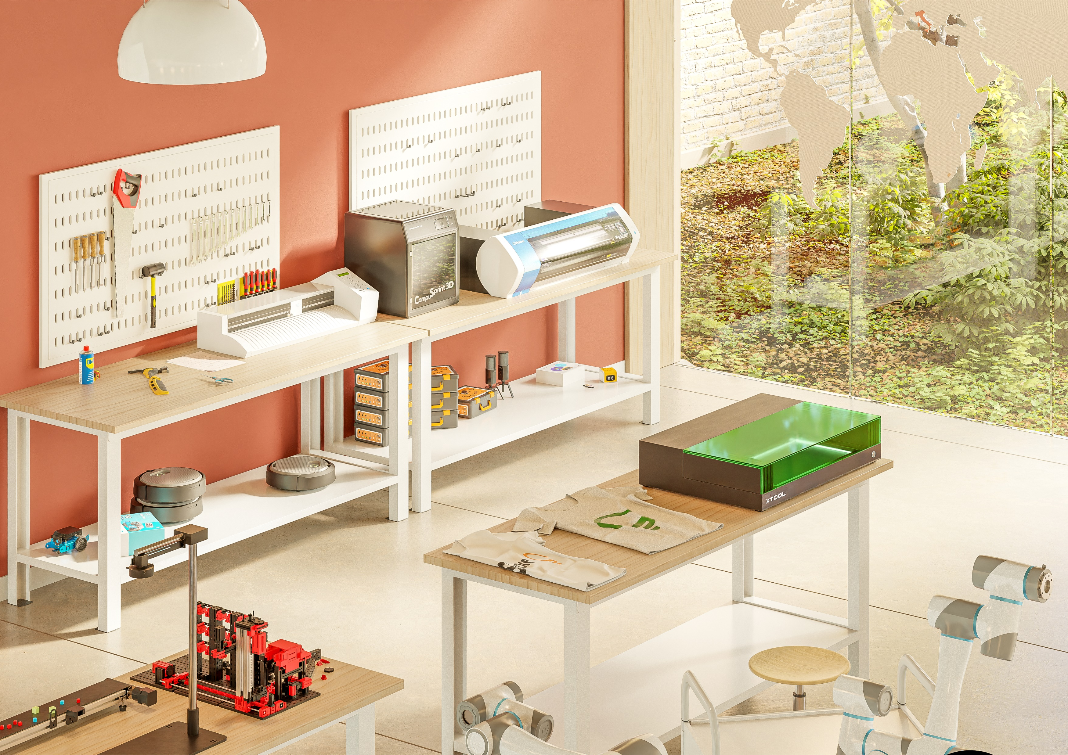
Complete educational projects
We sell all the durable goods that an educational space needs
CampuStore is a knowledge-based company, with more than 30 years of experience in the industry
Awarded as best LEGO Education partner worldwide in 2023
The biggest STEAM and educational robotics catalogue in Europe
We are not suppliers of products but a project partner
We offer
Advice based on educational knowledge and experience
Example of ‘’ready-to-use’’ packages (customizable)
Customized and tailored projects
The main e-commerce for education in Italy

Slide 3

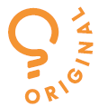

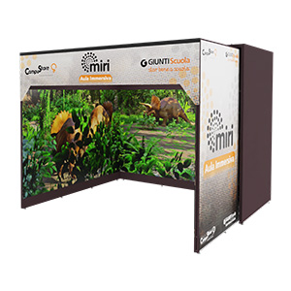
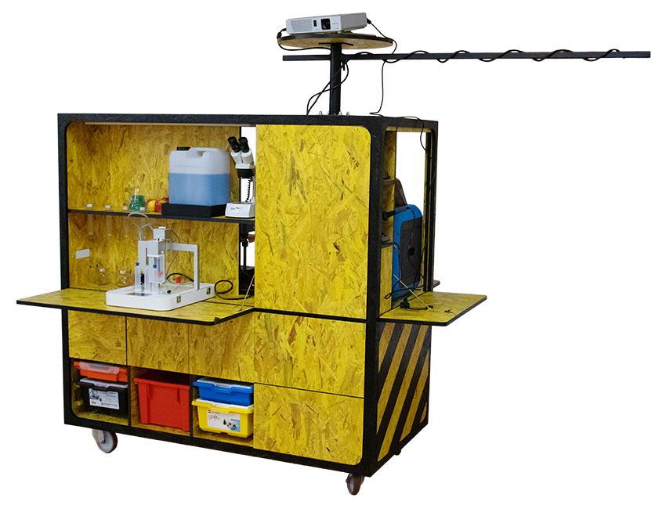
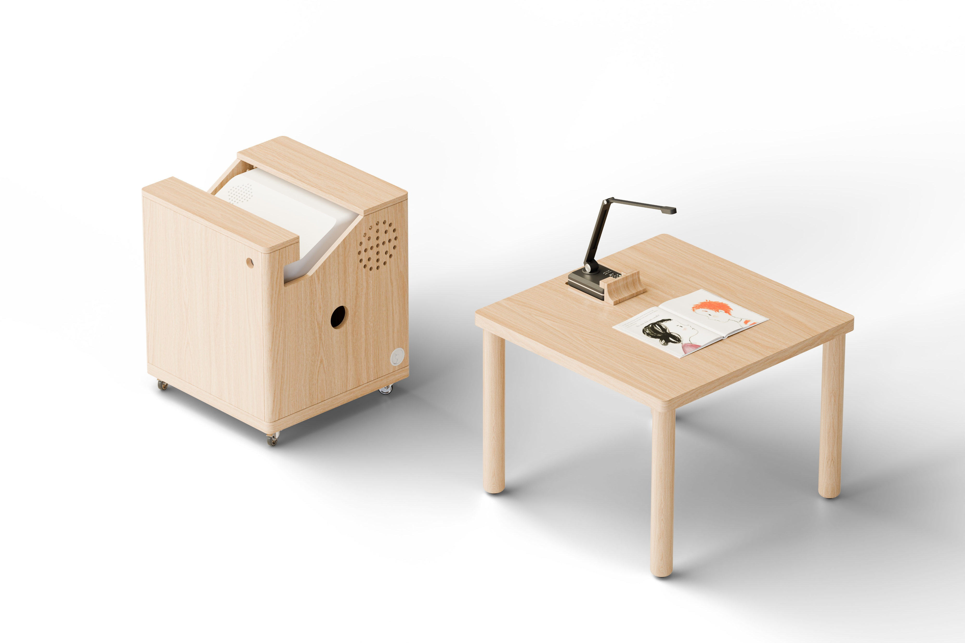

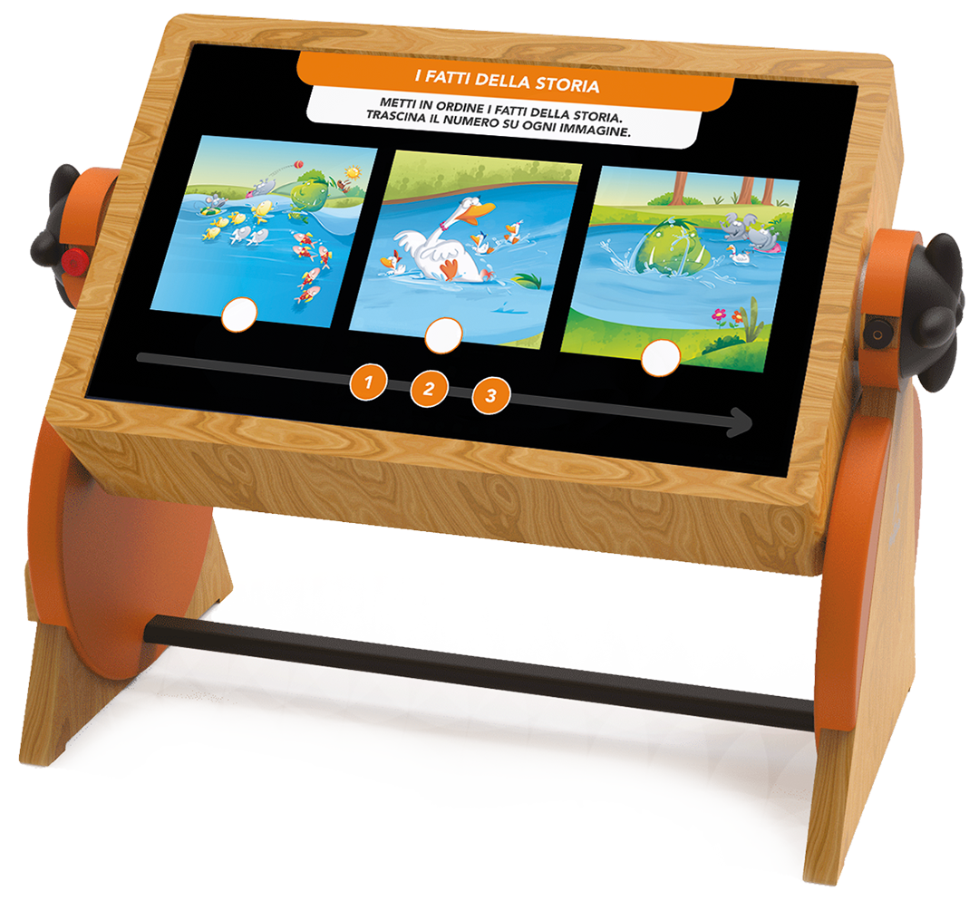
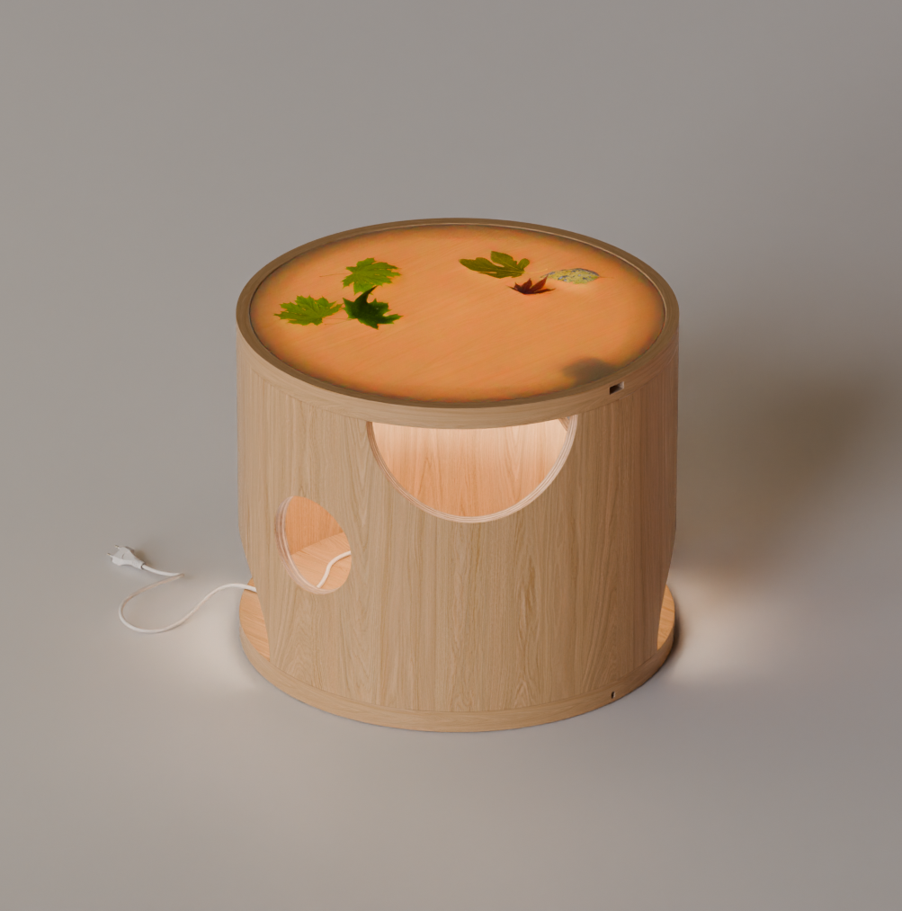
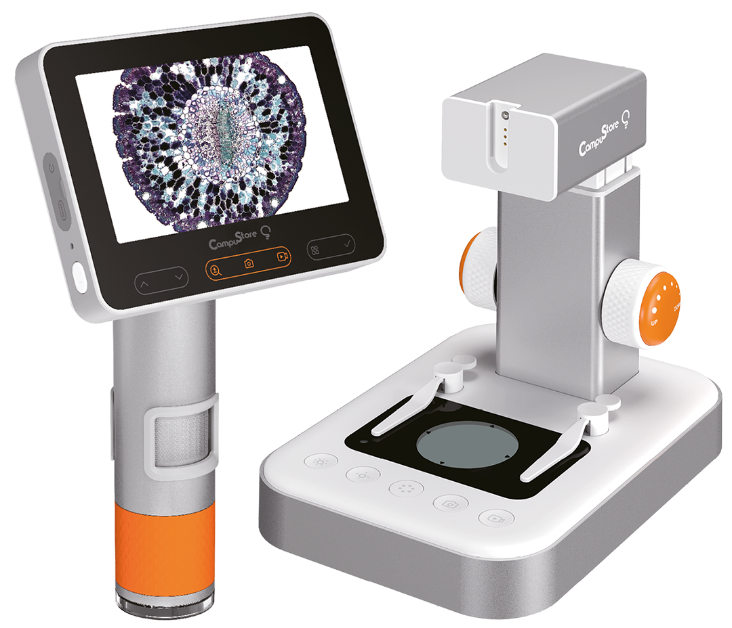
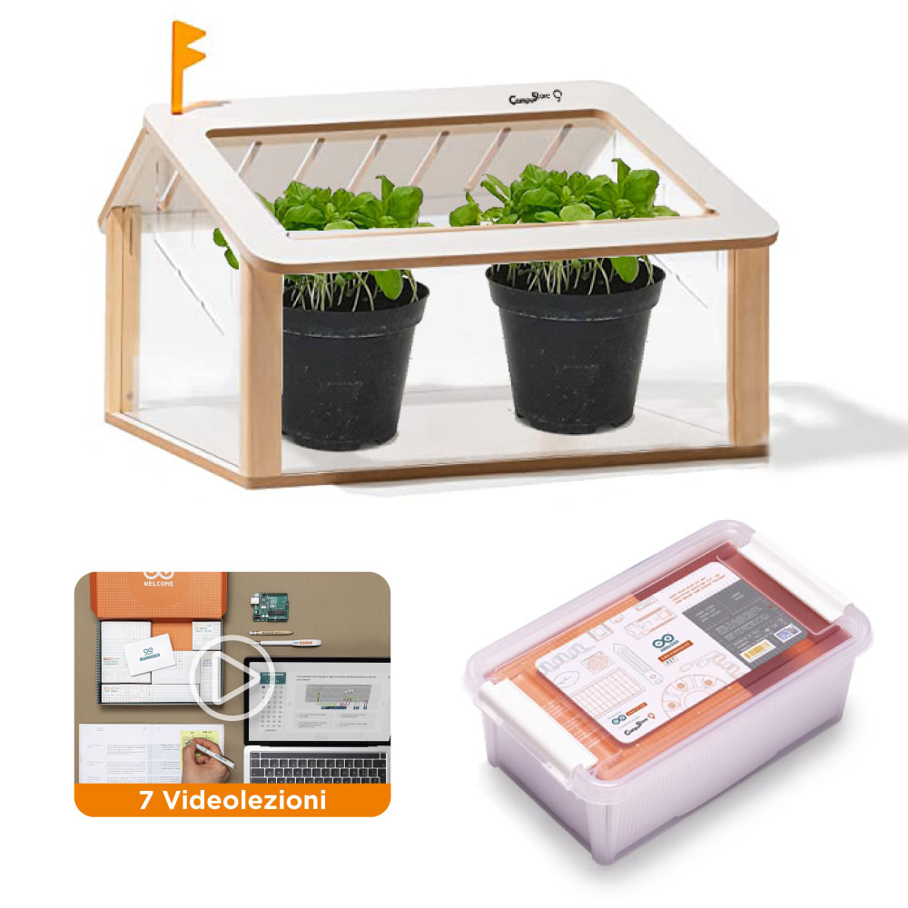
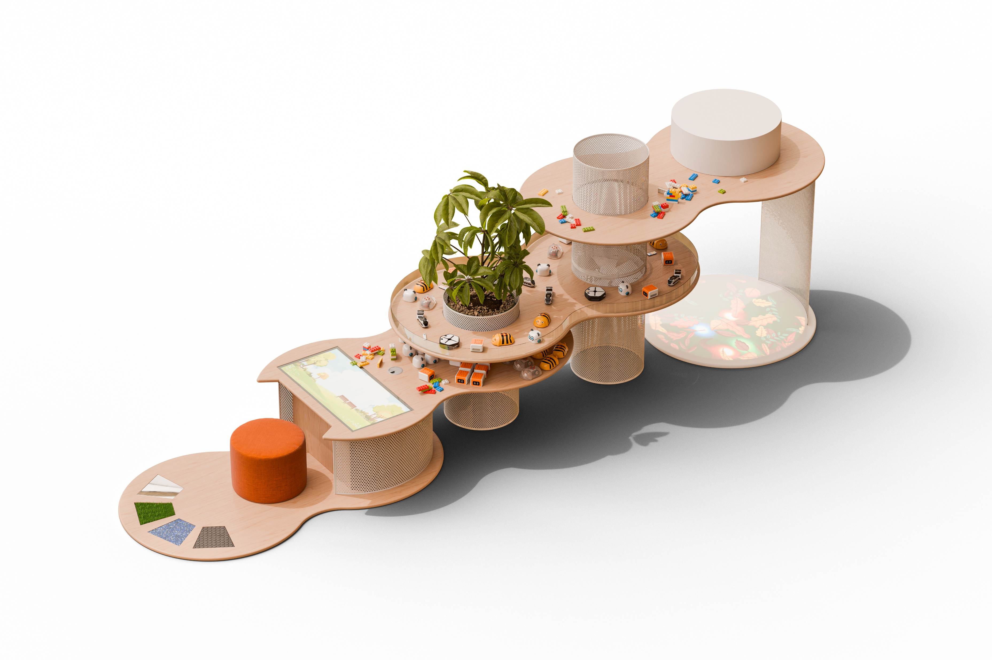
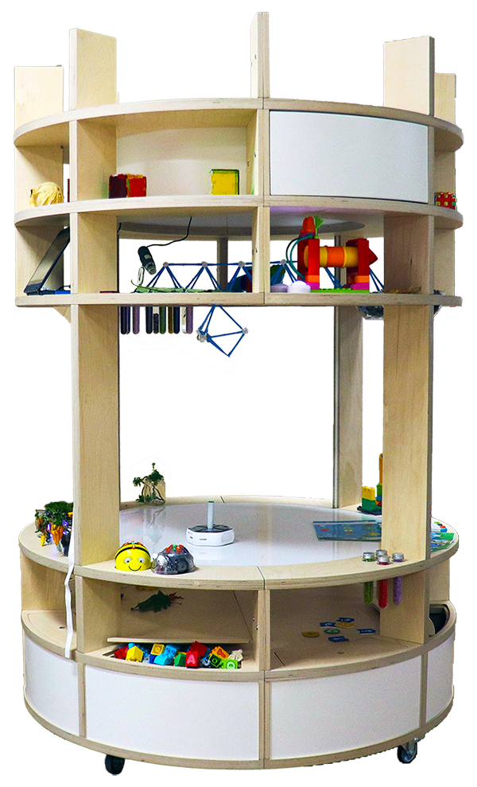
WATCH the video
Original Products Development
Miri
The only real immersive
room for edu context
CarrellONE
A complete STEAM lab on wheels
MagicPages
An innovative solution to support reading skills
Artificial intelligence AI
eduXia & CampusAI
Pinguin
A 2 side table for digital and hands-on learning
i-Vulcani
Discover the world
Arduino Greenhouse
Invented and developed by CampuStore
Loggy
The light theather
Catterpillar
A multi level support
CampuScope
For all age levels
WINNER

Slide 4
web: www.campustore.com
Blog : www.innovationforeducation.it
E-mail: sales@campustore.com
Facebook: www.facebook.com/CampuStoreIT
Instagram: www.instagram.com/campustore.it

